Slide 1

Interaction & Perception
Notes:
A good visualization allows us to drill down and find out more; it’s what Krish and Maglio (1994) call epistemic actions – activities that uncover new information. If the interaction doesn’t support uncovering new and hopefully useful data patterns then it’s really just clutter. We’re going to discuss several common interactions based in perception and ways to apply these.

Slide 2
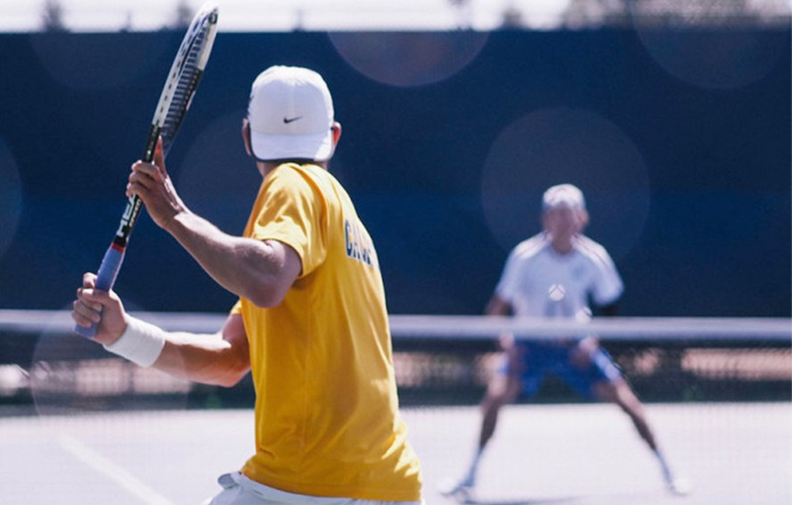
Reaction Times
Notes:
Photo: http://www.dailycal.org/2015/02/24/no-14-cal-mens-tennis-falls-stanford-defeats-gaels-gauchos/

Slide 3
Three Types of Feedback Loops
Data selection and manipulation
Most important for interactive visualization
Exploration and navigation
Problem solving

Slide 4
Simple Reaction Times
Optimal (finger at the ready)
~130 ms (Kohlberg, 1971)
Infrequent (still at the ready)
Up to 700 ms (Warrick et al., 1964)

Slide 5
Choice Reaction Times
Hick-Hyman law:
Reaction Time = a + blog₂(C)
Where C = number of choices,
a and b are constants.
log₂(C) is info processed by human in bits

Slide 6
Choice Reaction Times
Hick-Hyman law:
dealing with choice is expensive

Slide 7
be careful of too much visual noise
Notes:
There are numerous factors found to impact the choice reaction time, including the amount of visual noise and the degree of accuracy. This means avoid visual clutter in design and allow people to make mistakes. Example of two designs. One with buttons too close and lots of noise.

Slide 8
System Response Times

Slide 9
Three Thresholds
0.1 s for visual continuity, feels like real time
animations, sliders
1 s for reasonable system response
pause in conversation
10 s for process expected to be slow
cognitive response
threshold for suspecting system is broken

Slide 10
Fitts’s Law
Selection time = a + b log₂(D/W + 1)
D = distance to target
W = width of target
log₂(D/W + 1) is index of difficulty (in bits)
1/b = index of performance (in bits/s), roughly constant, typically ~4

Slide 11
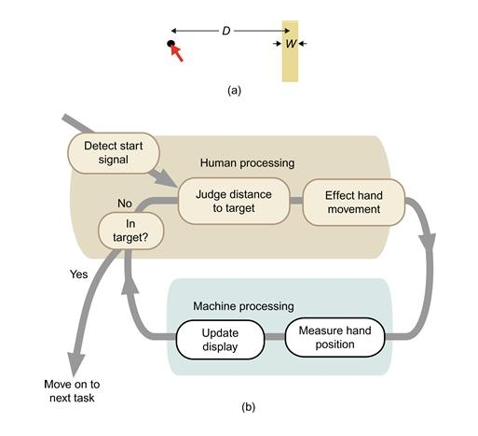
Diagram source: Ware, 2010

Slide 12
Fitts’s Law
time increases as distance to target increases
time increases as width of target gets smaller

Slide 13
Fitts’s Law
Keep controls that you want users to easily move between near each other.
Make click targets large.
Keep controls that users should use rarely away from commonly used controls.

Slide 14
Fitts’s Law
Submit
Delete All

Slide 15
Shneiderman’s Viz Tasks
Overview first,
zoom and filter,
details on demand.

Slide 16
Taxonomy of Infoviz Tasks
Overview – see overall patterns, trends
Zoom – see subset
Filter – see subset based on attributes
Details on demand – see more about specific object
Relate – see relationships, compare values
History – keep track of actions and insights
Extract – mark and capture specific data

Slide 17


